Slide 1
CS 2600 Computer Networks I
Dr. Sayeed Sajal Chapter 3: Internetworking
Lecture 24
Packet Switching and
Datagram Networks

Slide 2
Internetworking is the process of using routers to interconnect possibly heterogeneous (unlike) networks. The resulting system is known as an internet.

Slide 3
Comparing the Two Models*
*Still Dave’s opinion

Slide 4
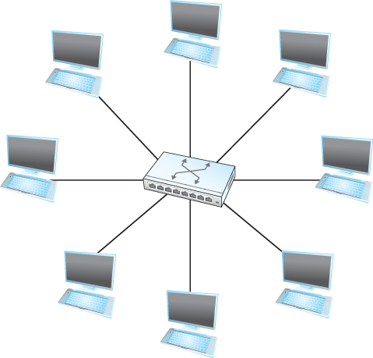
Figure 3.1 A Switch Provides a Star Topology

Slide 5
Multiple Switches Provide a “Mesh” Topology

Slide 6
Architecture of Packet Switches and Routers
*Typically used as a last resort. Most commercial switches and routers are
managed remotely using a web browser.
†Homogeneous in switches, heterogeneous in routers (where they may be
called “interfaces” instead of ports).

Slide 7
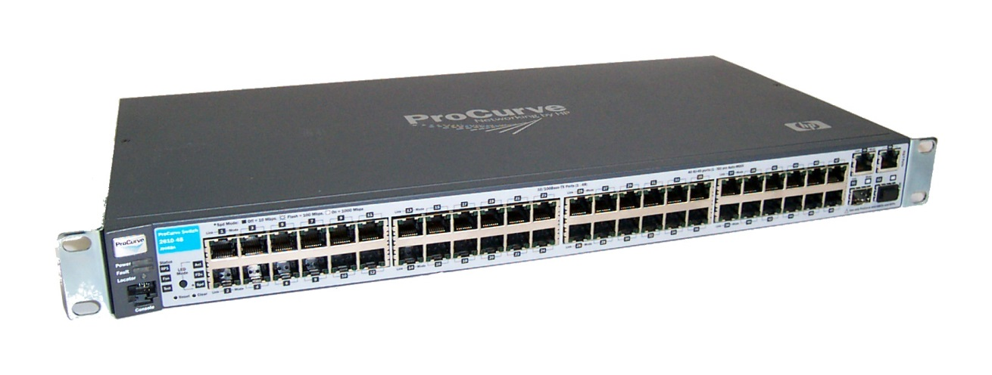
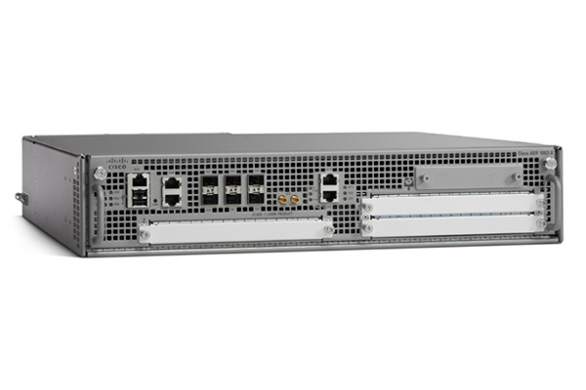
Comparing Switch & Router Port* Configurations
Ethernet ports
HP Ethernet Switch
Router interfaces
Cisco Router
*On a router, a “port” is usually called an “interface”

Slide 8
The Relationship Between Frames and Packets in the OSI Model
Principle 3: A packet is encapsulated within frames

Slide 9
Functions Performed by a Packet Switch (or Router)
Handle messages arriving on input ports and quickly forward them out of the appropriate output port
Store incoming messages in a memory buffer until the output port becomes available
Acquire and organize information about possible path(s) to each destination
Switches use a switching protocol like Spanning Tree
Routers use routing protocols such as RIP, OSPF and BGP

Slide 10
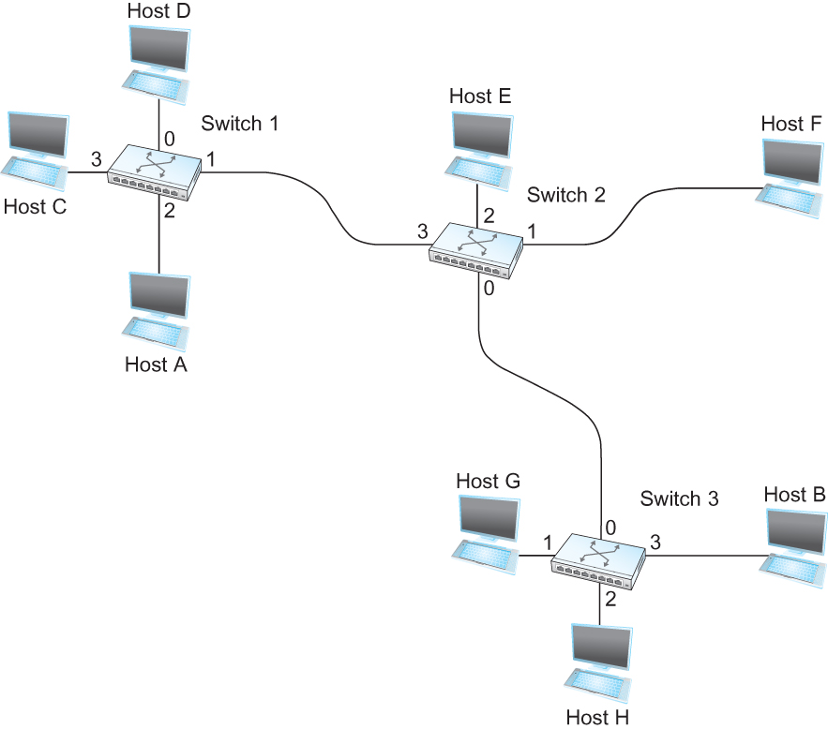
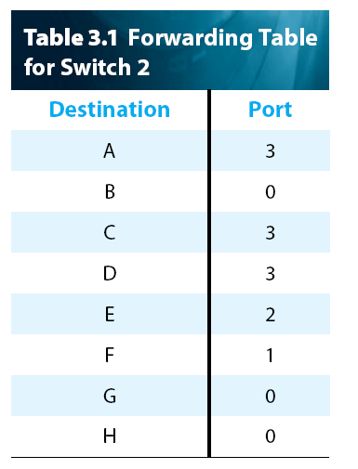
Datagram Forwarding: An Example Network
1. The packet arrives at a switch (or router) inside of a frame. The frame is checked for errors
and the packet is removed.
2. The global destination address is obtained from the packet header and compared to
addresses in the forwarding table, until a match is found.
3. A new frame is created, the packet is
inserted into the frame and transmitted
out the port indicated in the forwarding
table.
Figure 3.2 Datagram forwarding: an example network.

Slide 11
Characteristics of Datagram Protocols
No delay while waiting for connection to be established (no connection, so no handshake)
No guarantee that the packet (datagram) will be delivered (no ACK)
May handle network failure more gracefully than connection-oriented packet switching protocols
Undesirable overhead from having to carry two potentially large addresses in every packet header
Since there’s no connection, datagram routers/switches have no way to anticipate or control switching load – this can result in “dropped” packets

Slide 12
Congestion vs. Contention
Congestion occurs when a switch or router becomes overwhelmed with packets, runs out of buffer space (RAM) and begins to discard (“drop”) the extra packets.
Contention is a related (but less serious) problem that occurs when one or more packets received by a switch or router are forced to wait in a queue for an outbound port, while the transmission of other packets ahead of it completes. Hence the term queuing delay.

